Slide 1
Semantic D0SL SDK

Slide 2
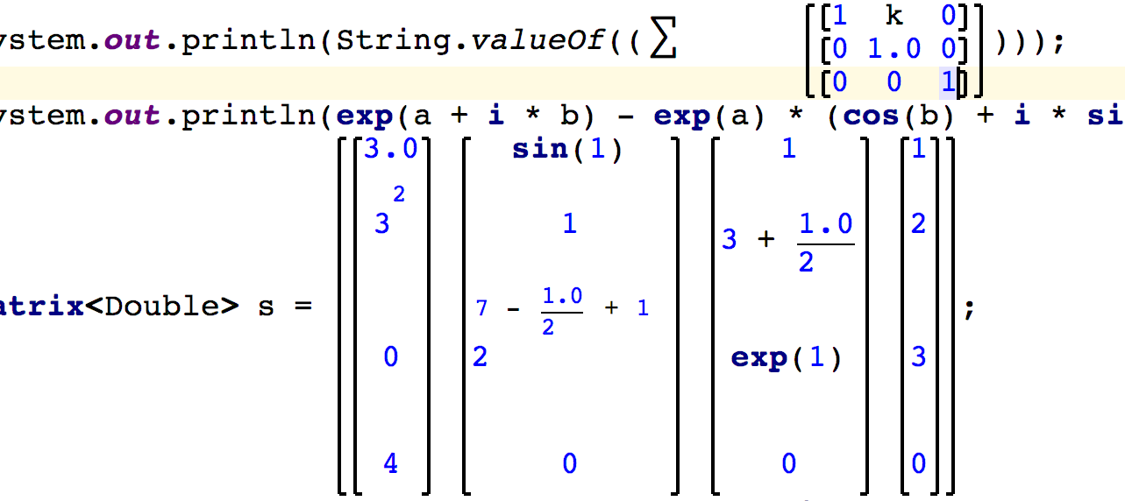
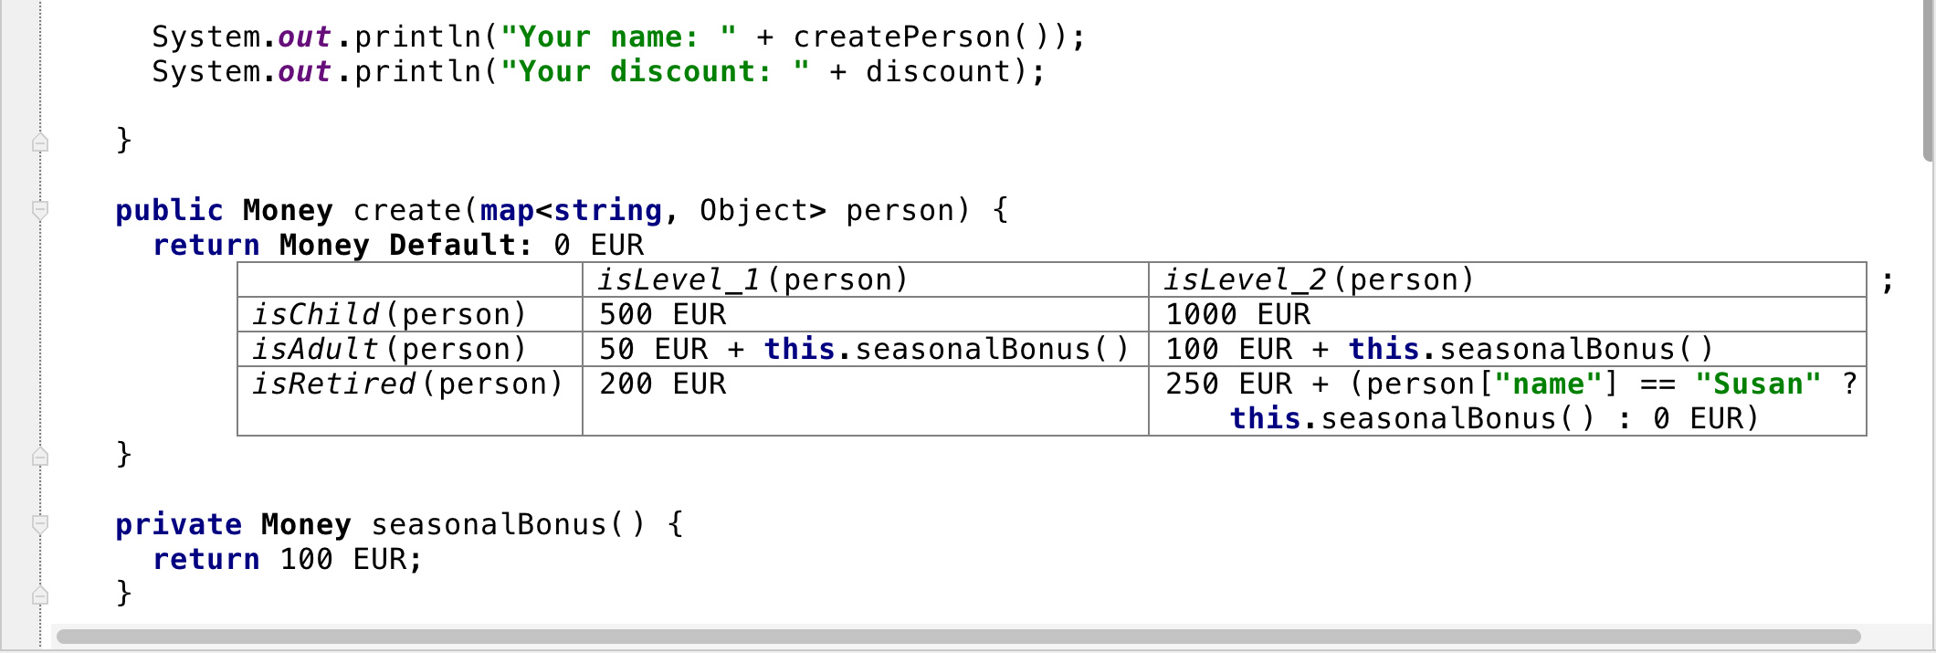
MPS Meta Programming System
Domain-specific Language
Express your domain processes and knowledge in a language that directly uses the concepts and logic from your particular field.
Projectional Editor
Communicate with terminology that everyone in your field understands. Use non-textual notation with projectional editing including math notations, diagrams, and forms.

Slide 3
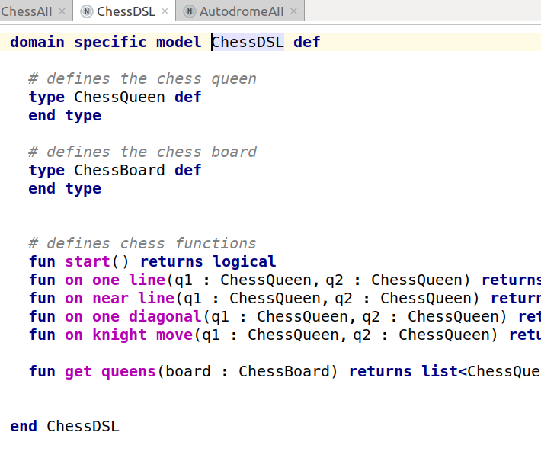
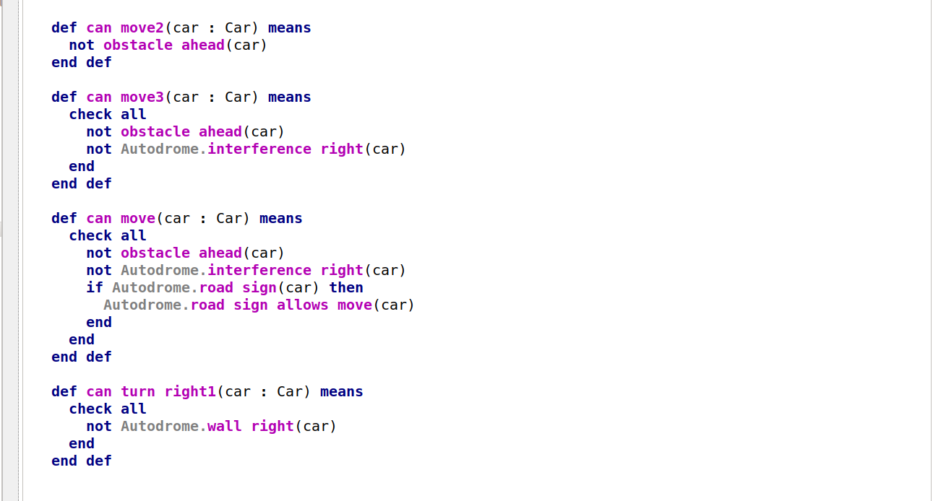
D0SL - Delta 0 Semantic Language
Basic DSL language
Corresponds to the mathematical theory of semantic modeling based on mathematical logic
Simple enough and understandable
Top-level DSLs can be developed that will be broadcast in D0SL and automatically executed in the Semantic Environment

Slide 4
AST – Abstract Syntax Tree
Java AST
IF
DSL1 AST
DSL2 AST
THEN
ELSE
DO
ЕСЛИ
i=1
j=2
i=2
j=1
CASE
CASE
ТО
ИНАЧЕ
1
2
2
1
А:=1
Б:=2
А:=2
Б:=1
html
js
css
config

Slide 5
General Structure
Workplace
MPS & Delta0 Semantic Language
Java Model
XML Model
JAR
XML
JAR
Semantic Environment
Applications call predicates on specific semantic model. One application can use several models.
REGISTRY
MACHINE
DOMAIN SPECIFIC LIBRARY
HTTP

Slide 6
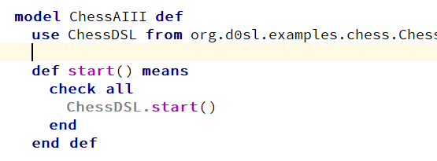
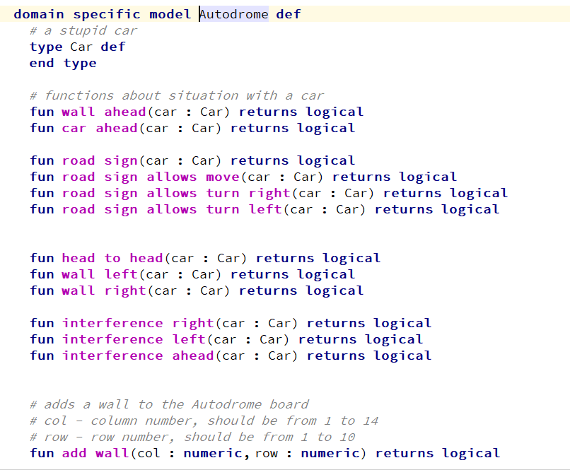
Delta 0 Semantic Language
Language structure
use model
D0SL Language
Semantic Model
rules
Domain Model
predicates
Domain Types
Types
Logical (true, false, none)
Numeric (Double)
String
Domain Object (Typedef)
Logical expressions
And, Or, Not
Implication (if-then-else)
For all (in restricted list)
Check all (‘And’ with multiple operands)
Local variables (final, local constant)
Arguments
Domain Function Calls
Domain Functions

Slide 7
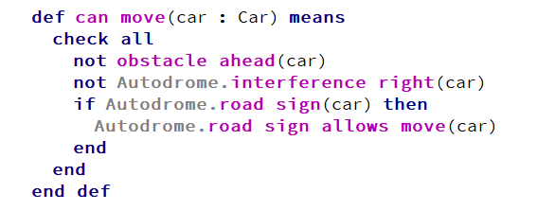
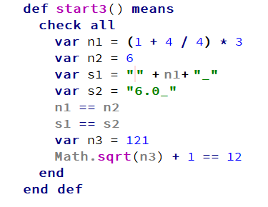
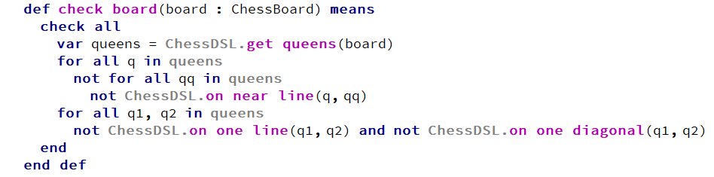
Language examples

Slide 8
Editor tips in MPS and D0SL
aliases | effect
Ctrl+space | Code completion
Alt+enter | Intentions menu
Ctrl+w | Item (incremental) selection
def | Creates predicate definition
use | Creates ‘use’ keyword
check | Check all keyword
and, or, not | Logical operation
“ | “”, string value
for | For all keyword
if | Implication (if)
Insert, enter | When needs to insert argument for predicates or functions
aliases | effect
var | Local variable (inside check-all)
fun | Creates function in Domain Model
typedef | Creates domain type in Domain Model

Slide 9
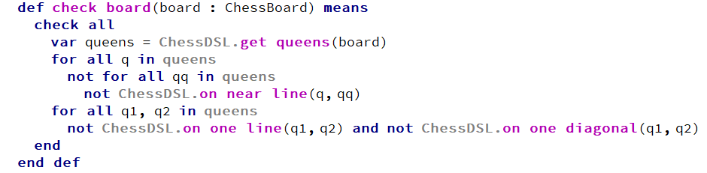
Chess queens example
Robot
Semantic Environment
Domain
Chess Model
Randomly arranges 8 queens
If the position ok?
Don't any two queens on the board eat each other?
If OK then exit

Slide 10
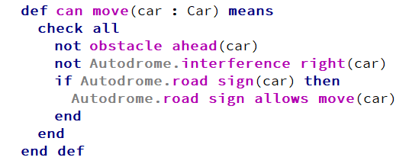
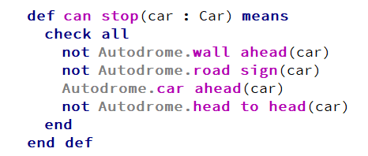
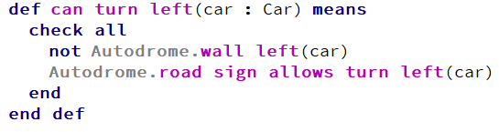
Autodrome example
Autodrome AII
Semantic Environment
Domain
Autodrome Model
For every robocar
Can move?
Can stop?
Can turn left?
Can turn right?
Choosing possible action according some priorities.

Slide 11
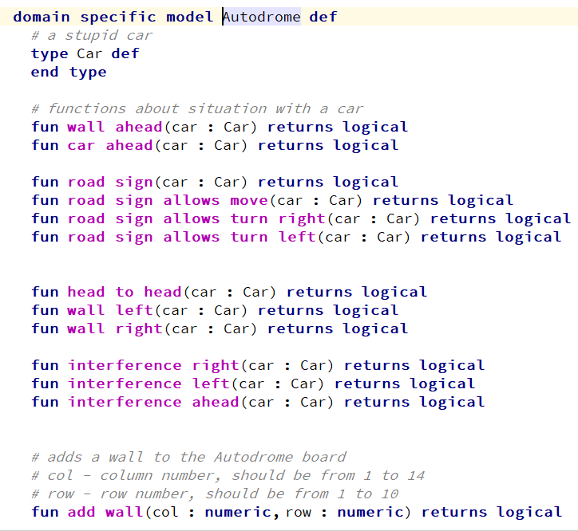
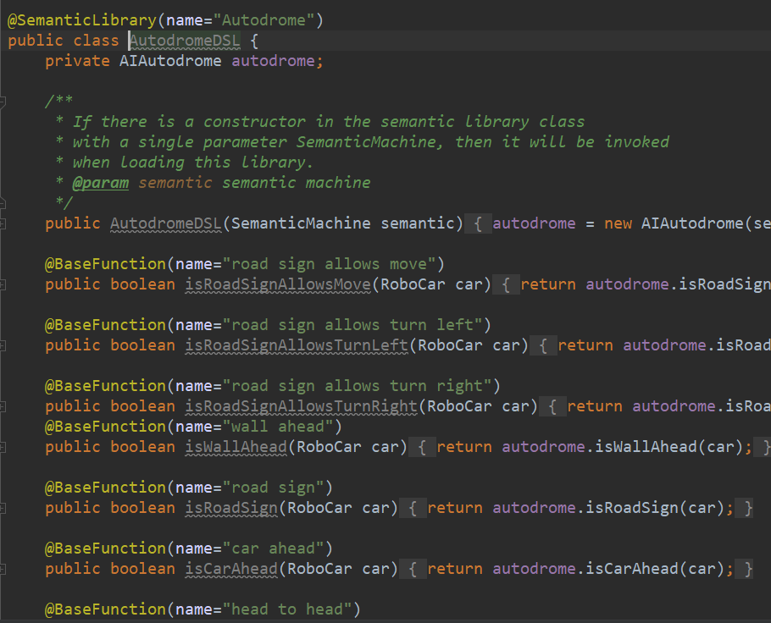
Autodrome Domain implementation example

Slide 12
Basic steps to run local Semantic Environment
Semantic
Environment
Create Semantic Environment
Load Domain models
Load Semantic models
Run predicate on specific model

Slide 13


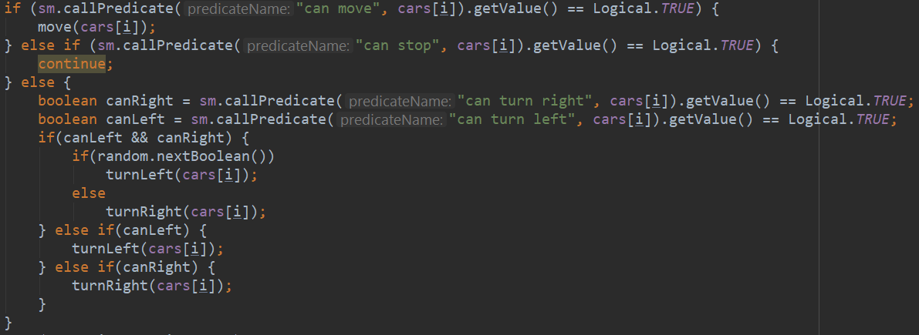
Examples to run local Semantic Environment

Slide 14
Load D0SL SDK https://github.com/kirikprotocol/examples-d0sl

